Slide 1
Fuzzy Inference Systems

Slide 2
Content
The Architecture of Fuzzy Inference Systems
Fuzzy Models:
  Mamdani Fuzzy models
  Sugeno Fuzzy Models
  Tsukamoto Fuzzy models
Partition Styles for Fuzzy Models

Slide 3
Fuzzy Inference Systems
The Architecture of
Fuzzy Inference Systems

Slide 4
Fuzzy Systems
Fuzzifier
Inference
Engine
Defuzzifier
Input
Output
Fuzzy
Knowledge base

Slide 5
Fuzzy Control Systems
Input
Fuzzifier
Inference
Engine
Defuzzifier
Plant
Output
Fuzzy
Knowledge base

Slide 6
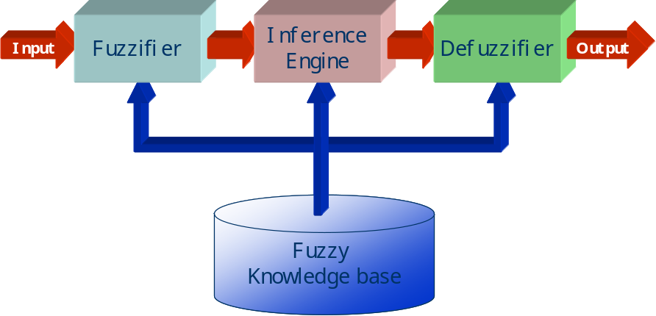
Fuzzifier
Converts the crisp input to a linguistic variable using the membership functions stored in the fuzzy knowledge base.

Slide 7
Fuzzifier
Converts the crisp input to a linguistic variable using the membership functions stored in the fuzzy knowledge base.

Slide 8
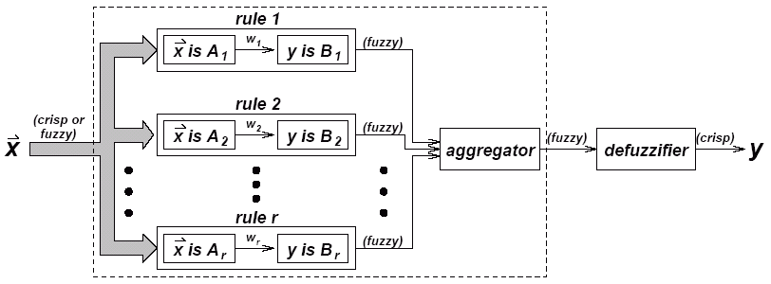
Inference Engine
Using If-Then type fuzzy rules converts the fuzzy input to the fuzzy output.

Slide 9
Defuzzifier
Converts the fuzzy output of the inference engine to crisp using membership functions analogous to the ones used by the fuzzifier.

Slide 10
Nonlinearity
In the case of crisp inputs & outputs, a fuzzy inference system implements a nonlinear mapping from its input space to output space.

Slide 11
Fuzzy Inference Systems
Mamdani
Fuzzy models

Slide 12
Mamdani Fuzzy models
Original Goal: Control a steam engine & boiler combination by a set of linguistic control rules obtained from experienced human operators.

Slide 13
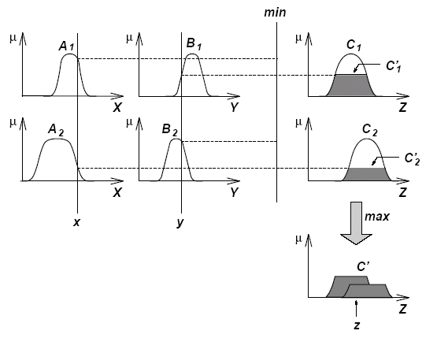
Max-Min Composition is used.
The Reasoning Scheme

Slide 14
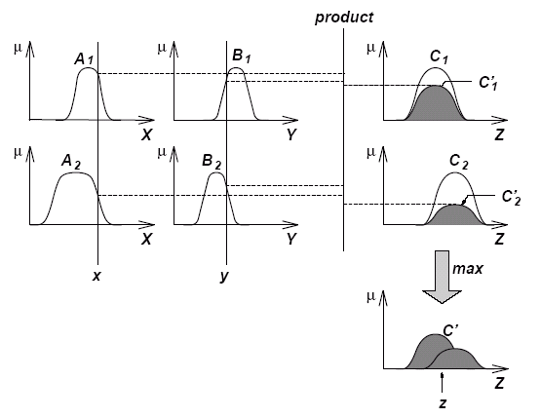
Max-Product Composition is used.
The Reasoning Scheme

Slide 15
Defuzzifier
Converts the fuzzy output of the inference engine to crisp using membership functions analogous to the ones used by the fuzzifier.
Five commonly used defuzzifying methods:
  Centroid of area (COA)
  Bisector of area (BOA)
  Mean of maximum (MOM)
  Smallest of maximum (SOM)
  Largest of maximum (LOM)

Slide 16
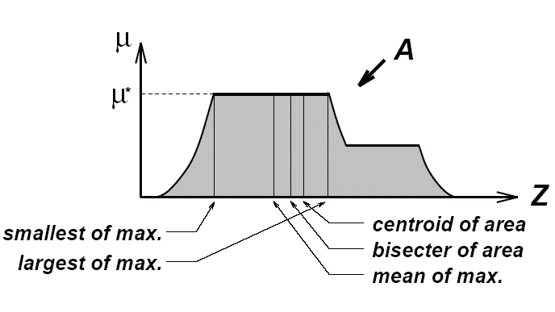
Defuzzifier

Slide 17
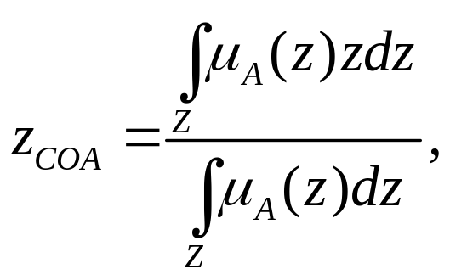
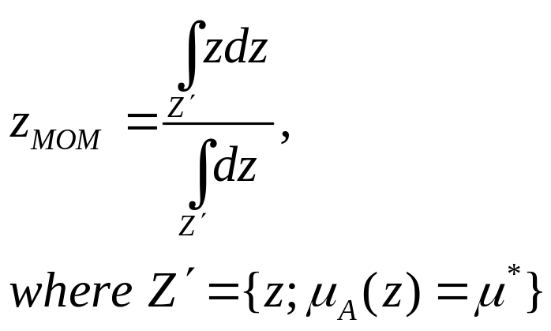
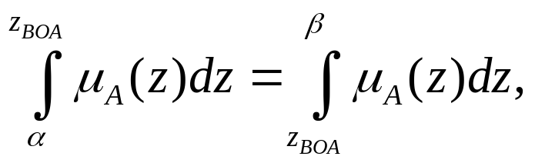
Defuzzifier

Slide 18
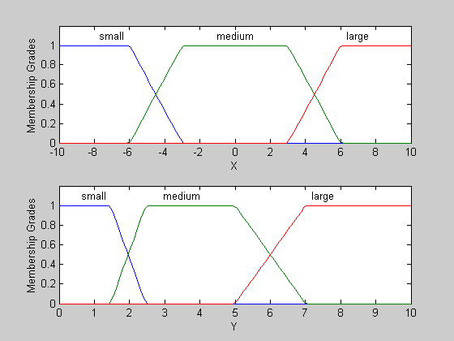
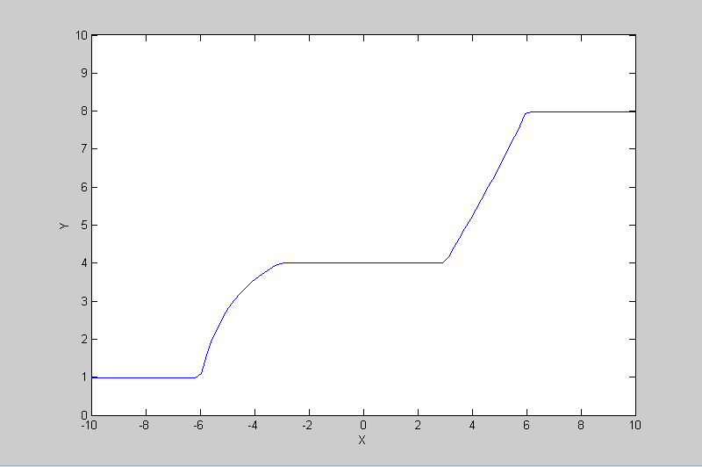
        R1 : If X is small then Y is small
        R2 : If X is medium then Y is medium
        R3 : If X is large then Y is large
Example
        X = input ∈ [−10, 10]
        Y = output ∈ [0, 10]
Max-min composition and centroid defuzzification were used.
Overall input-output curve

Slide 19
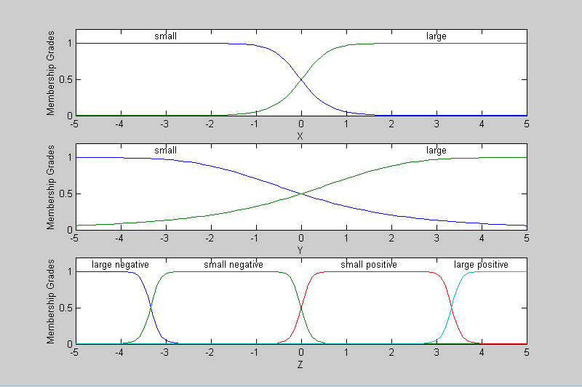
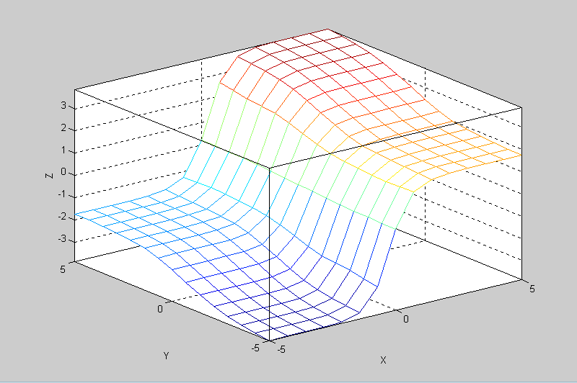
        R1: If X is small & Y is small then Z is negative large
        R2: If X is small & Y is large then Z is negative small
        R3: If X is large & Y is small then Z is positive small
        R4: If X is large & Y is large then Z is positive large
Example
        X, Y, Z ∈ [−5, 5]
Max-min composition and centroid defuzzification were used.
Overall input-output curve

Slide 20
Fuzzy Inference Systems
Sugeno
Fuzzy Models

Slide 21
Sugeno Fuzzy Models
Also known as TSK fuzzy model
  Takagi, Sugeno & Kang, 1985
Goal: Generation of fuzzy rules from a given input-output data set.

Slide 22
Fuzzy Rules of TSK Model
If x is A and y is B then z = f(x, y)
Fuzzy Sets
Crisp Function
f(x, y) is very often a polynomial function w.r.t. x and y.

Slide 23
Examples
R1: if X is small and Y is small then z = −x +y +1
R2: if X is small and Y is large then z = −y +3
R3: if X is large and Y is small then z = −x +3
R4: if X is large and Y is large then z = x + y + 2

Slide 24
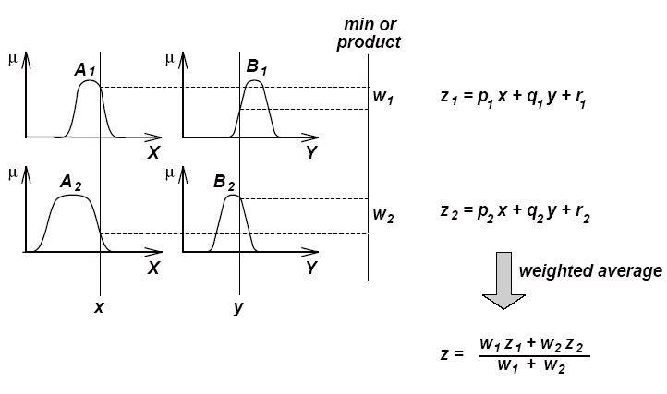
The Reasoning Scheme

Slide 25
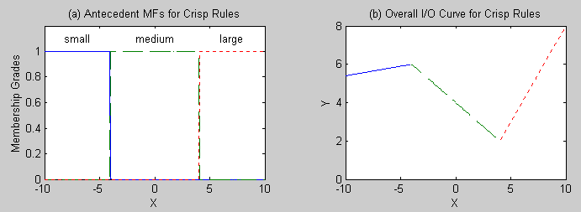
R1: If X is small then Y = 0.1X + 6.4
R2: If X is medium then Y = −0.5X + 4
R3: If X is large then Y = X – 2
Example
        X = input ∈ [−10, 10]
unsmooth

Slide 26
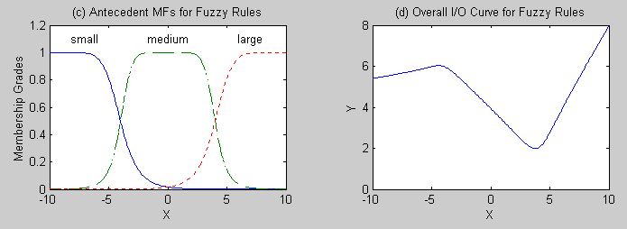
R1: If X is small then Y = 0.1X + 6.4
R2: If X is medium then Y = −0.5X + 4
R3: If X is large then Y = X – 2
Example
        X = input ∈ [−10, 10]
If we have smooth membership functions (fuzzy rules) the overall input-output curve becomes a smoother one.

Slide 27
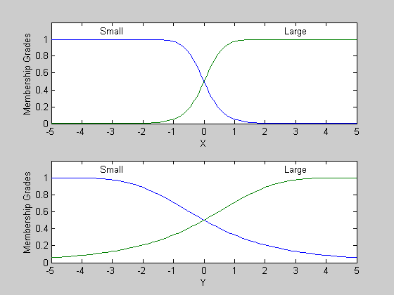
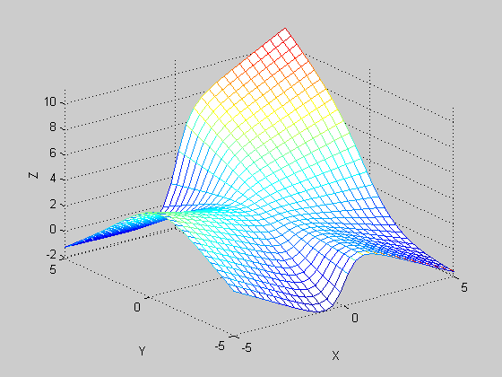
R1: if X is small and Y is small then z = −x +y +1
R2: if X is small and Y is large then z = −y +3
R3: if X is large and Y is small then z = −x +3
R4: if X is large and Y is large then z = x + y + 2
Example
        X, Y ∈ [−5, 5]

Slide 28
Fuzzy Inference Systems
Tsukamoto
Fuzzy models

Slide 29
Tsukamoto Fuzzy models
The consequent of each fuzzy if-then-rule is represented by a fuzzy set with a monotonical MF.

Slide 30
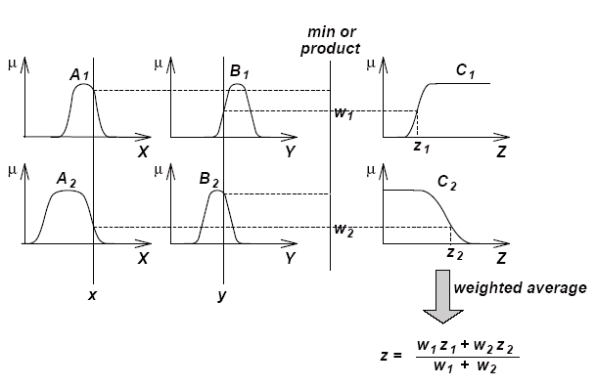
Tsukamoto Fuzzy models

Slide 31
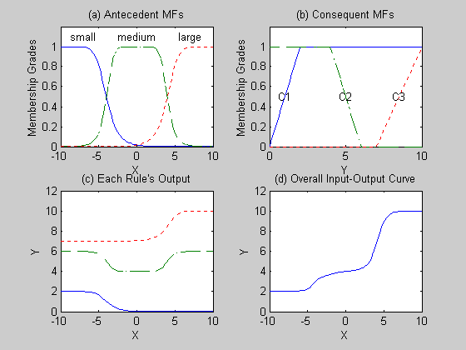
R1: If X is small then Y is C₁
R2: If X is medium then Y is C₂
R3: if X is large then Y is C₃
Example

Slide 32
Fuzzy Inference Systems
Partition Styles for Fuzzy Models

Slide 33
Review Fuzzy Models
The same style for
  Mamdani Fuzzy models
  Sugeno Fuzzy Models
  Tsukamoto Fuzzy models
Different styles for
  Mamdani Fuzzy models
  Sugeno Fuzzy Models
  Tsukamoto Fuzzy models
If <antecedence> then <consequence>.

Slide 34
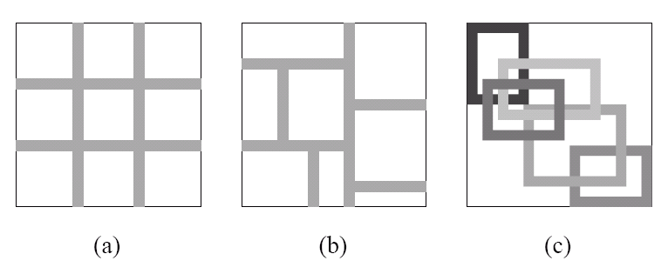
Partition Styles for Input Space
Grid
Partition
Tree
Partition
Scatter
Partition

